Slide 1









Introduction to MARQUIS2
For Study Pharmacists
Jeffrey L. Schnipper, MD, MPH, FHM
Director of Clinical Research, BWH Hospitalist Service
Associate Physician, Division of General Medicine,
Brigham and Women’s Hospital
Associate Professor, Harvard Medical School
Stephanie Labonville, PharmD, BCPS
Clinical Pharmacy Specialist, BWH
Manager of Clinical Operations, Injured Workers Pharmacy

Slide 2
Case 1 - History of Present Illness
60 year old female with non-ischemic cardiomyopathy and progressive biventricular heart failure is admitted for management of acute-on-chronic systolic heart failure and possible heart transplant
Scheduled admission to CHF service
  Overflow to general cardiology service
  Late admission to a busy long-call team
2

Slide 3
Case 1 - Past Medical History
Hypertension
Hyperlipidemia
Diabetes mellitus type II
Hypothyroidism
Non-ischemic cardiomyopathy (EF 20-30%)
  Severe mitral regurgitation
  Moderate aortic stenosis
  Moderate to Severe tricuspid regurgitation
  Severe pulmonary hypertension
  Right ventricular dysfunction
3
Notes:
- Colostomy done to prevent decubs

Slide 4
Case 1 – Home Medications
Losartan 50 mg daily
Spironolactone 25 mg daily
ASA 81 mg daily
Furosemide 80 mg BID
Digoxin .250 mg daily
Carvedilol 6.25 mg BID
Pravastatin 40 mg daily
Omeprazole 40 mg daily
Saxagliptin/Metformin 5 mg /1000 mg daily
Levothyroxine 25 mcg daily
4

Slide 5
Case 1 – Hospital Course
During admission history and physical exam, patient provided handwritten list of home medications which included “levothyroxine 25 mg” to the admitting intern
Due to busy admitting day, team resident used list to fill out Pre-Admission Medication List (PAML)
During PAML creation, resident noted levothyroxine units and converted dose to 250 mcg daily. Correct conversion would be 25,000 mcg daily.
Because patient was new to Partners there was no medications from electronic sources to help generate PAML
5

Slide 6
Case 1 – Hospital Course
Intern, fellow and attending admission notes all report home levothyroxine dose as 250 mcg
On HD#2, PAML is reviewed by pharmacist who reconciles admissions orders with PAML – this does not include independent verification of preadmission medications
On HD#3, transplant pharmacist reviews preadmission medications with patient, who verbally confirms erroneous dose
Patient continues to receive 250 mcg of levothyroxine daily for the next 20 days
6
Notes:
Responds “yes” to “are you tking 250 mcg levothyroxine daily”

Slide 7
Case 1 – Hospital Course
Patient listed for heart transplant
PA catheter placed for directed therapy with inotropic agents and diuretics
HD#18 patient develops fevers and hypotension. Patient is started on antibiotics given concern for mixed septic and cardiogenic shock
HD#20 patient is transferred to CCU given refractory hypotension
Taken to cath lab urgently for placement of intra-aortic balloon pump
7
Notes:
Maryann Mello is a 68 years 6.3 months F adm 8/9 ef 15 moderate as, non ischemic, severe mr unclear if secondary tocardiomyopathy or primary insult admitted on the August 5th for advanced therapy for CHF, listed for transplant mid august. She was doing ok while being diuresed with lasix 200 BID daily and PA artery catheter monitoring. Right hart Cathon 08/06 that showed Elevated Left Heart Filling Pressures with PCWP= 32 mmHg, as well as severe mitral regurg, moderate AS. Follow up Right heart Cath on 08/19 showed Right IJ ocluded, L IJ small caliber, showed normal right filling pressures, with increased PCWP at 21.
She was doing well until this friday when she spiked a fever of 100.8. Throught the hospital stay her BP 80's - 90's, however, blood pressures dropped to the SBP in the 70's. Blood and Urine Cultures , were sent and has showed ngtd. She had been on Dobutamine 5, and Dopamine 2 mcg, and had dopamine increased to 3 once her bp dropped. However, she became tachycardic to the 150's, and Dopamine was D/C . Given the concern for a mix cardiogenic and septic shock, she was started on Vanc/Cefepime/ on 08/24. She has a positive urine culture from 08/10 which was resistant to cipro and had a 5 day course of Bactrim (08/12-08/16). Prior to trasnfer to the CCU, she has been persistent tachy with lower blood pressures and patient did not appeared well and had altered mental status, feeling very somnolent. Concerning if for worsening cardiogenic vs superimposed septic shock. She was started on flagyl today given episodes of lose stools. She had lasix boluses stopped on 08/24 and was started on a lasix dripp. The Dripp was D/C given low blood pressures and altered sensorium. Her PA line was pulled given concern for infection. She will require a Swan ganz catheter place and right heart cath to help elucidate causes of acute decompensation and guide management.
Other issues she has been hyponatremic with worsening with low blood pressures, thought to be secondary tohypovolemia.
‎
‎
swan to see bp's consider IABP. beside echo showed looked relatively same with stable RV, LV with colasping IVC on inspiration . ABG 7.4/102/‎. She is being listed for Transplant. hyponatremic in the floor, most likely hypovolemia. Plummeted to mid 120's with worsening blood pressures. Thought is R heart cath, will give better sense of SVR, consider treatment of sepsis like standpoint, but if it looks more cardiogenic, IABP will be inserted. Chest x-ray cleared x 2, PA line was pulled on Friday.

Slide 8
Case 1 – Labs on CCU Transfer
TSH: 0.153 (admission 3.95)
Free T4: 3.8 (nl 0.9-1.7)
8

Slide 9
Case 1 – Hospital Course
Endocrinology consulted and felt that decompensation consistent with thyrotoxicosis
On detailed review with patient, she reported taking “oval, salmon colored pill” which is consistent with 25 mcg levothyroxine
Outpatient pharmacy confirmed dose of 25 mcg levothyroxine for > 1 year
Levothyroxine discontinued
9

Slide 10
Case 2 - History of Present Illness
62-year-old man with stage IV B-cell lymphoma admitted from rehabilitation facility with febrile neutropenia
Overnight admission to oncology service
  Passed off to house staff oncology service in morning
10

Slide 11
Case 2 – Past Medical History
Chronic obstructive pulmonary disease
Atrial fibrillation
Viral hepatitis C
Chronic low back pain
B-cell lymphoma
11

Slide 12
Case 2 – Pre-Admission Medications
1. Acyclovir (Acyclovir) 400 MG PO TID
2. Albuterol Inhaler Hfa 1 PUFF INH Q4H prn wheezing
3. Allopurinol 300 MG PO QD
4. Amiodarone 200 MG PO QD
5. Amitriptyline Hcl 12.5 MG PO QHS
6. Artificial Tears 2 DROP BOTH EYES 6x daily
Apply to right eye
7. Ascorbic Acid (Vitamin C) 250 MG PO QD
8. Calcium Carb Chewable 1000mg(400mg Elem Ca) (Tums Ultra 1000) 2 TAB PO TID prn Other:Heartburn
9. Chlorhexidine Mouthwash 0.12% (Peridex Mouthwash) 10 ML SWISH & SPIT BID
10. Docusate Sodium (Colace) 100 MG PO BID
11. Dutasteride / Tamsulosin 1 CAPSULE PO QD
12. Entecavir 0.5 MG PO QD
13. Ergocalciferol 50000 UNITS PO QWEEK
14. Fentanyl (Patch) 50 MCG TD Q72H
15. Fluconazole 200 MG PO QD
16. Fluticasone Prop/Salmeterol 250/50 (Advair Diskus 250/50) 1 INHALATION INH BID
17. Lasix (Furosemide) 40 MG PO BID
18. Lacri-Lube Ointment 1 APPLICATION LEFT EYE QHS
19. Lactulose 20 mg PO QID
20. Loratadine (Claritin) 10 MG PO QD
21. Metoprolol Succinate Extended Release 50 MG PO QD
22. Miconazole Nitrate 2% Powder 1 APPLICATION TP BID
23. Moxifloxacin Ophthalmic (Tid) (Vigamox) 1 DROP RIGHT EYE QID
24. Multivitamins 1 TAB PO QD
25. Nystatin Suspension (Mouthwash) 10 ML SWISH & SWALLOW QID
26. Olanzapine Odt (Zyprexa Zydis) (Zyprexa Zydis) 5 MG PO BID
27. Ondansetron Hcl (Chemo N/V) 8 MG PO Q8H prn nausea
28. Oxycodone 5 MG PO UNKNOWN
29. Pantoprazole 40 MG PO BID
30. Prochlorperazine Maleate (Compazine ) 10 MG PO Q6H prn nausea
31. Sennosides (Senna Tablets) 17.2 MG PO BID
32. Tiotropium 18 MCG INH QD
33. Trimethoprim /Sulfamethoxazole Single Strength (Bactrim Ss) 1 TAB PO QD
34. Trypsin - Balsam Peru - Castor Oil Ointment 1 APPLICATION TP BID
35. Zinc Sulfate 220 MG PO QD
12

Slide 13
Case 2 – Hospital Course
On night of admission, accurate PAML was created using medication list from rehab facility
Admitting intern manually entered each pre-admission medication into order entry as opposed to PAML to Order Entry function
Amitriptyline dose was inadvertently entered as 200 mg daily (mistaken with dose of amiodarone) – 16-fold increase from outpatient dose
Approved by pharmacist one hour later, did not use medication list comparison function
13
Notes:
Depression: Oral: 50-150 mg/day single dose at bedtime or in divided doses; dose may be gradually increased up to 300 mg/day.
Chronic pain management (unlabeled use): Oral: Initial: 25 mg at bedtime; may increase as tolerated to 100 mg/day.
Diabetic neuropathy (unlabeled use): Oral: 25-100 mg/day (Bril, 2011)
Migraine prophylaxis (unlabeled use): Oral: Initial: 10-25 mg at bedtime; usual dose: 150 mg; reported dosing ranges: 10-400 mg/day
Post-traumatic stress disorder (PTSD) (unlabeled use): Oral: 75-200 mg/day

Slide 14
Case 2 – Hospital Course
Started on broad spectrum antibiotics for suspected pneumonia
At 8:30 am on HD#2 received scheduled dose of 200 mg amitriptyline
At 9:45 am patient became hypotensive and delirious
Received 2L NS and was started on bicarbonate drip given concern for TCA toxicity
Transferred to ICU for further management
14

Slide 15
Background
Adverse Drug Events (ADEs) are an epidemic patient safety problem
  Definition: Any injury due to medication
    Includes side effects, overuse, underuse, misuse
  ADEs: 5-40% of hospitalized patients, 12-17% post-discharge
15

Slide 16
Medication Safety at Transitions
Transitions of care (e.g., in to and out of the hospital) are vulnerable times for patients
  Multiple medication changes
  Rushed event, inadequate patient education
  Discontinuity of care, inadequate follow-up
16

Slide 17
Medication Errors at Transition
Inappropriate Prescribing
Medication Discrepancies: Type 1
  Unexplained differences among documented regimens across different sites of care
Medication Discrepancies: Type 2
  Differences between what patients think they should be taking and the regimens collectively ordered by their physicians
  “Unintentional non-adherence”
Non-adherence
  Differences between what patients think they should be taking and what they actually take
Inadequate monitoring and follow-up
  Disease control
  Non-adherence
  Side effects
17

Slide 18
Medication Discrepancies: Type 1
“History Errors”
  Example: Team doesn’t know patient taking ASA, not recorded, not ordered at admission or discharge
  Sources inaccurate, out of date, unavailable
  Lack of time to access available sources
“Reconciliation Errors”
  Example: ASA on preadmission medication list, held on admission, not restarted at discharge
  Lack of access to preadmission medication list, clerical error
  Problem more common at discharge

Slide 19
Medication Discrepancies 1: Typology
Discrepancies
Intentional
Unintentional
Documented
Undocumented
Potential for Harm
No Potential for Harm
History Error
Reconciliation Error
Admission
Discharge
Admission
Discharge
Omission
Dose
Frequency
Route
Substitution
Additional Medication
Formulation
Other
19

Slide 20
Medication Reconciliation Errors in the
Control Group of Partners RCT
Discrepancies
N = 2066
Intentional
1127 (55%)
Unintentional
939 (45%)
Documented
Undocumented
Potential for Harm
257 (27%)
No Potential for Harm
682 (73%)
History Error
186 (72%)
Reconciliation Error
78 (30%)
Admission
57 (22%)
Discharge
129 (50%)
Admission
10 (4%)
Discharge
68 (26%)
Omission
150 (60%)
Dose
53 (21%)
Frequency
24 (10%)
Route
0 (0%)
Substitution
9 (4%)
Additional Medication
12 (5%)
Formulation
1 (0.4%)
Other
0 (0%)
20

Slide 21
Interventions to Improve Patient Safety
During Transitions in Care
Medication Reconciliation
Patient/caregiver education and counseling
Post-discharge follow-up
21

Slide 22
Interventions to Improve Patient Safety
During Transitions in Care
Medication Reconciliation
Patient/caregiver education and counseling
Post-discharge follow-up
22

Slide 23
Medication Reconciliation
“A process of identifying the most accurate list of all medications a patient is taking… and using this list to provide correct medications for patients anywhere within the health system.”
Institute for Healthcare Improvement. Medication Reconciliation Review. 2007; http://www.ihi.org/IHI/Topics/PatientSafety/MedicationSystems/Tools/Medication+Reconciliation+Review.htm
23

Slide 24
What Does Med Rec Involve?
Taking a “Best Possible Medication History” (BPMH)
Writing orders based on medication history
Comparing regimens across transitions (e.g., preadmission, current inpatient, discharge)
Updating lists and orders as more information becomes available
Identifying and correcting discrepancies
Communicating with patient re: how new regimen is different from the old regimen (new, changed, stopped)
Communicating with next provider/site of care
24
Notes:
BPMH – the single most important step to improving medication safety during transitions in care…but also often the most difficult:
*Patients and caregivers may not know what medications they take
*Sources of information are inaccurate and out of date
*No one person takes responsibility for maintaining an accurate list
*Fragmented healthcare system
*Information sources and providers don’t talk to each other
Goal of BPMH: obtain complete information on the patient’s preadmission medication regimen (Name of each medication, Formulation (e.g., extended release), Dosage, Route, Frequency
*What supposed to be on vs what they actually take
*Other important information, including: Allergies and associated reactions | Name, specialty, contact info of prescribers | Name and phone number (or town) or pharmacy(ies)
Consulting other sources of information and Comparing lists - try to use > 2 sources of information when possible and explore discrepancies between them
*Patient (via interview or patient-owned medication lists)
*Pill bottles
*Family members and other caregivers
*Pharmacy(ies) where patient fills prescriptions
*Medication lists and/or notes from outpatient providers
*Discharge medication orders from recent hospitalizations
*Transfer orders from other facilities

Slide 25

MARQUIS 1 Study Aims
1. Develop a toolkit of best practices for med reconciliation
2. Conduct a multi-site mentored quality improvement (QI) study
3. Assess effects of QI interventions on unintentional medication discrepancies with potential for patient harm
4. Conduct rigorous program evaluation to determine
  Most effective components of a med rec program
  How best to implement them
Funded by AHRQ (R18 HS019598)
25

Slide 26
Results of MARQUIS 1
1 site did not implement any interventions during the study period
Of the remaining 4 sites, 3 of them had improvements in their potentially harmful discrepancy rate
The 4th site implemented a new vendor EHR and saw its rate of discrepancies markedly increase
26

Slide 27
Interrupted Time Series Analysis
When adjusted for baseline performance, baseline temporal trends, and any control units, implementation of the intervention was associated with a significant improvement in total medication discrepancy rates over time
  9% reduction in discrepancies per month, over baseline trends, compared with control units
Adjusted for patient age, service, insurance, marital status, number of prior admissions, number of high-risk medications, Elixhauser comorbidity score, DRG weight, median income by zip code, and season; clustered by site, with number of meds as model offset
27

Slide 28
Component Analysis Results
Sites implemented anywhere from 1 to 7 different components
Components were implemented by anywhere from 1 to 4 sites
28

Slide 29
Results of Component Analysis
3 Intervention components associated with significant reductions in potentially harmful discrepancy rates
  Hiring additional staff (usually pharmacists) to assist with discharge medication reconciliation and patient counseling
  Training existing staff to do the same
  Clearly defining roles and responsibilities
Expanding an existing “medication reconciliation assistant” program was also successful
Implementing a vendor EHR hospital-wide had a negative effect
29
Adjusted for patient age, service, insurance, marital status, number of prior admissions, number of high-risk meds, season, and study site

Slide 30
Barriers and Facilitators
Degree of institutional support critical, associated with
  Perceived alignment of med rec QI efforts with institutional priorities (e.g., readmission reduction)
  Stakeholders’ belief in potential of intervention to reduce costs, increase patient safety, etc.
Concurrent QI interventions
  Barrier if competed for time, attention, and resources
  Facilitator if able to integrate and ride on coat-tails of existing efforts (e.g., post-discharge med education program for high-risk patients)
Political process took time and often could not be rushed
  Getting clinicians and leadership on board for substantial changes in policies, processes, and procedures
Sometimes it took a sentinel event to overcome resistance and convert agnostics and adversaries into advocates
30

Slide 31
Lessons Learned Regarding Intervention
Insufficient to teach providers to perform a BPMH and assume competency
  Sites needed to establish a certification process
BPMH training may be most effective as peer-to-peer, so trainer can model the work directly
Decentralized vs. centralized pharmacists each have advantages and disadvantages
  Decentralized: part of rounds, participation is organic and in real-time, already know the patients, easier to counsel patients before discharge
  Centralized: can deploy efficiently to highest risk patients on demand and depending on supply
PR campaigns could be effective in changing attitudes about med rec (regulatory requirement vs. safety imperative)
Important to makes roles/responsibilities explicit, hold stakeholders accountable
HIT improvements are an iterative process
31

Slide 32
Next Steps
MARQUIS 1 worked
In the process of doing it, we made the intervention better
  Refined the toolkit
  Learned many lessons about implementation
Now the toolkit is ready for prime time, broad implementation
Received funding from AHRQ for a second round of mentored implementation, with 18 sites
32
Notes:
Site 2
The QI team at this 535-bed community non-teaching hospital associated with a large regional healthcare system is led by the Vice President for Clinical Improvement, with other members of the team including hospitalists, clinical pharmacists, nurses, and the on-site study pharmacist. Their initial intervention targets included training in taking a BPMH and good discharge medication education as well as giving feedback to providers on the quality of their medication histories.
To date, progress has been made in 4 areas:
BPMH training: BPMH training video and pocket cards are used by nursing and pharmacy staff on target units to perform medication histories for patients who are directly admitted, transferred from other hospitals, or admitted on weekend nights. This complements a pre-existing initiative that utilizes pharmacy technicians, called Medication Reconciliation Assistants (MRAs), to take medication histories for all ED patients admitted during the week and weekend days.
Risk stratification: Development of an automated screening tool to identify high-risk patients and having clinical pharmacists attend daily discharge rounds to determine which patients require high-intensity discharge education.
High-intensity bundle in high-risk patients: Plans are in place to formally train a cohort of clinical pharmacists and discharging providers to provide high-intensity discharge education for high-risk patients .
Discharge education: The discharge education training video was placed on the organization’s intranet to complement existing education modules on “teach back” and “Ask Me 3,” a patient education program designed to promote communication between patients and clinicians.³⁵ Clinical pharmacists can now flag high-risk patients for intensive discharge counseling in their workflow database and see which high-risk patients have received in-hospital intensive counseling and which have not. This complements an existing program which provides post-discharge counseling by phone for a subset of patients (e.g., older patients with a PCP within a particular provider group, discharged home, referred to the program, or on multiple or high-risk medications) run by the regional healthcare system.
Key factors promoting success include the dedication of the QI team leader and on-site study pharmacist, full support from the leadership of the regional healthcare system, and integration of the intervention components with previously adopted site initiatives, such as the use of MRAs and the post-discharge education program for high-risk patients. Barriers have included a smaller QI team to lead intervention efforts, difficulty in engaging front-line staff, limited availability of MRAs on weekend nights and for patients not admitted through the ED (and over-reliance on MRAs even for patients in whom they are not available), lack of access to administrative data to help guide next steps, and lack of educators trained in the use of teach back.
As with Site 1, several lessons have been learned. Progress at Site 2 has been somewhat slower with less engagement from front line providers and a smaller QI team. Across both sites, our experience confirmed the important QI principle that education itself is not sufficient to change behavior to achieve best practice; certification of competency is required. A need for site-specific data to help make the case to front-line providers is also essential for ongoing engagement with the improvement effort, and is now a goal of the central data analysis team. For example, Site 2 needed to know medication discrepancy rates among patients not affected by MRAs (e.g., weekend night admissions, direct admissions) compared with other patients.
How does this relate to what is mentioned above for risk stratification? Are different people being trained to replace the pharmacists doing it now?
Jeff Schnipper: John and Jason, can you answer this question?
Jason: it’s a human resource allocation relationship, extending the responsibility to hospitalists rather than replacing pharmacists; specifically for the high risk patients not qualifying to receive discharge counseling from the existing post-discharge program (SafeMed) the work would have to be allocated across the clinical pharmacists and discharging hospitalists (both of which would be learners in a formal training program)

Slide 34
MARQUIS2 Study Aims
To implement the refined MARQUIS evidence-based medication reconciliation toolkit at 18 diverse hospitals, using a mentored quality improvement implementation model.
To rigorously evaluate the effect of the MARQUIS program on unintentional medication discrepancies.
To inform future spread of medication reconciliation interventions by performing an evaluation of program implementation using the RE-AIM framework.
Funded by AHRQ (R18 HS023757)
34

Slide 35
Setting and Patients
18 sites in 3 waves of 6 sites each
  Picked from 72 applications
  Variability by size, academic affiliation, geographic location, use of HIT
Adult patients on medical and surgical wards
Hospital staff involved in medication reconciliation process: residents, attendings, nurses, pharmacists, physician assistants, nurse practitioners, pharmacy technicians
35

Slide 36
Site Recruitment
Sites could be individual hospitals or several hospitals within a healthcare system
Requirements
  Strong institutional support
  Local site leader/ mentee with QI knowledge, experience, time
  Multi-disciplinary QI team
  Institutional experience with successful QI projects
  Availability of resources to collect data
  Intention to implement one or more intervention components
  Have not already implemented too many MARQUIS components
36

Slide 37
Site Recruitment
In addition, we sought diversity among the sites
  Geography: region of North America, urban vs. rural vs. suburban
  Academic medical center vs. community hospital
  Presence of residents
  Size
  Use of electronic health records
  Patient demographics
37

Slide 38
Sites
Phase 1 4/16 – 9/17 | Phase 2 7/16 – 12/17 | Phase 3 10/16 – 3/18
Cooper University Hospital | RWJ University Hospital Somerset | Denver Health Medical Center
University of Utah | Yale New Haven Hospital | University of Florida
Griffin Hospital | Niagara Health System | Mission Hospital
UC San Diego | UC Davis Medical Center | Doylestown Hospital
San Joaquin Community Hospital | Oregon Health and Science University | VA Boston Community Living Center
Johns Hopkins (3 hospitals) | McLeod Regional Medical Center | University of Kentucky Chandler Hospital
38

Slide 39
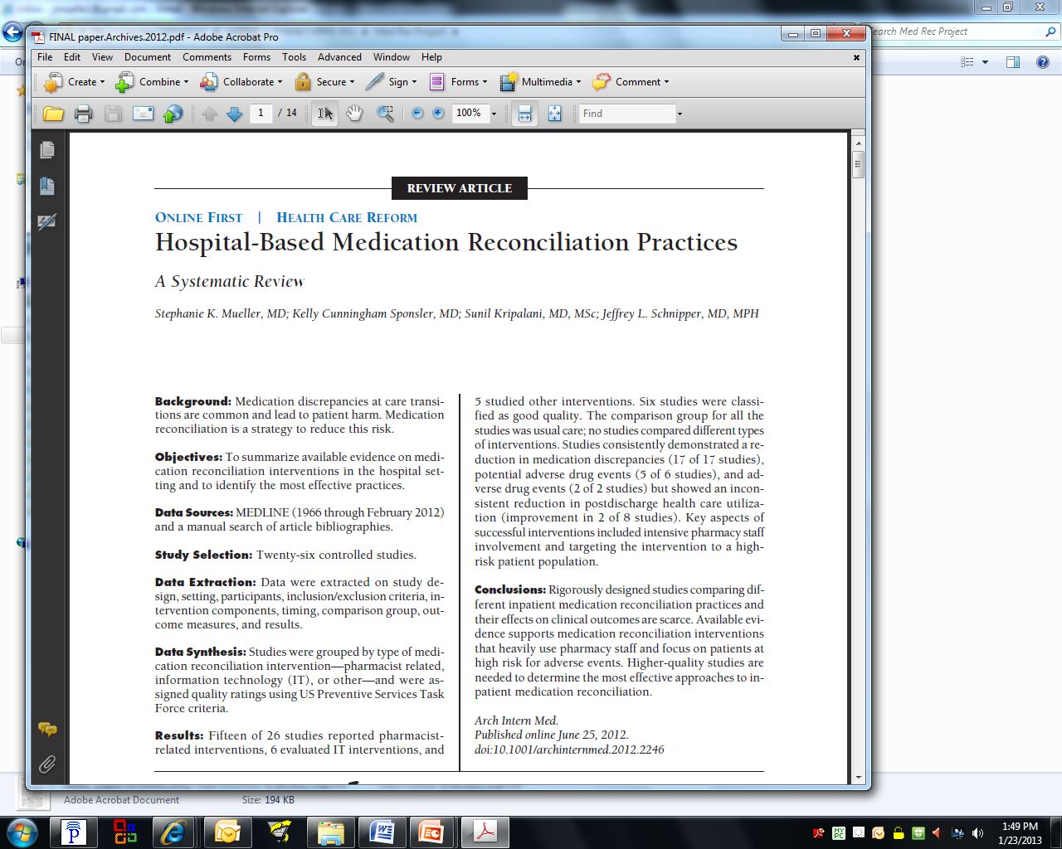
 | PHARMACIST | IT-RELATED | OTHER
↓ Medication Discrepancies | 10/10 | 3/3 | 4/4
↓ Potential Adverse Drug Events (PADE) | 2/3 | 1/1 | 2/2
↓ Preventable Adverse Drug Events (ADE) | 1/2 | 1/1 | ---
↓ Healthcare Utilization | 2/7 | 0/1 | ---
  Successful programs: Intensive pharmacy staff involvement
  Focus on high risk subset of patients
  Formed the basis of the intervention

Slide 40
MARQUIS2 Intervention Components
Medication Reconciliation Bundle
  “Best Possible Medication History”
  Reconciliation at discharge
  Patient counseling
  Forwarding information to next provider
Risk Assessment
  Intense vs. Standard Bundle depending on patient risk
Training providers in taking a BPMH and in performing discharge counseling
Improving access to preadmission medication sources
  Encouraging patient-owned medication lists
  Facilitating access to other medication sources (e.g., pharmacies)
Other high-risk, high-reward interventions
  Implementing and improving HIT
  Utilizing social marketing
  Engaging community resources
40

Slide 41
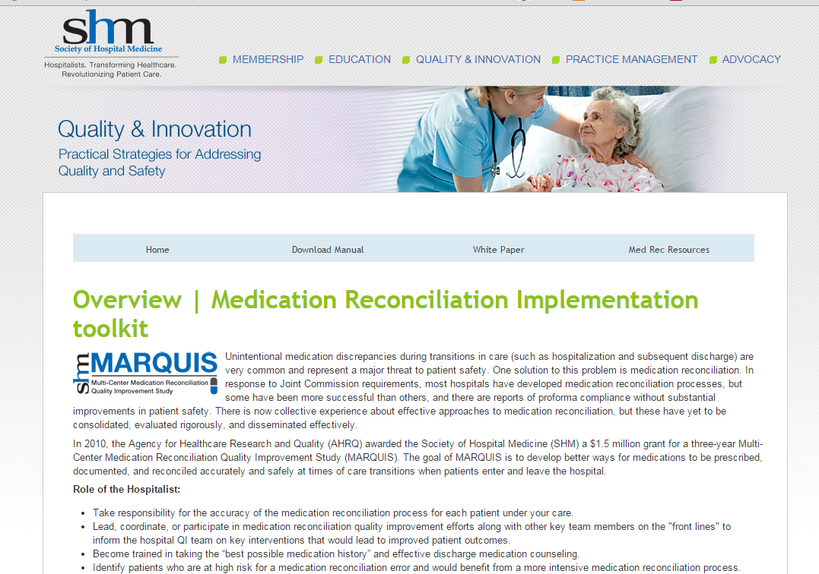
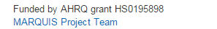
MARQUIS2 Toolkit

Slide 42
MARQUIS Toolkit*
  A compilation of the “best practices” around medication reconciliation, with resources to support deployment of the intervention components
      MARQUIS Implementation Manual
      Best Possible Medication History (BPMH) Pocket Cards
      Taking a Good Medication History Video
      Good Discharge Counseling Video
      ROI Calculator
      *All available for download at www.hospitalmedicine.org/marquis
42

Slide 43
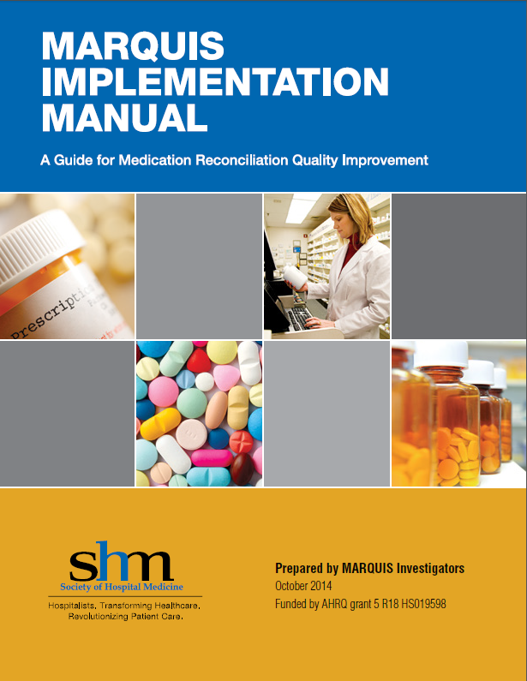
MARQUIS Implementation Manual
  Summarizes best practices in medication reconciliation
  Many great tools and examples!
  Intended to be adapted for local use
  Explains QI fundamentals and how they can be applied to medication reconciliation efforts
43
Notes:
Risk stratification
Patient-centered medication lists
Sample Social Marketing tools
BPMH Pocket Cards

Slide 44
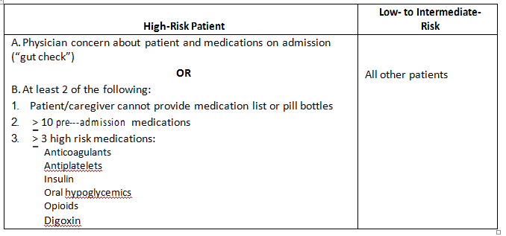
Risk Stratification Tool
44

Slide 45
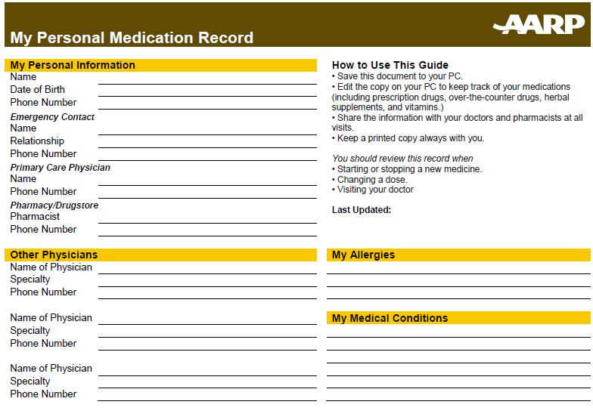
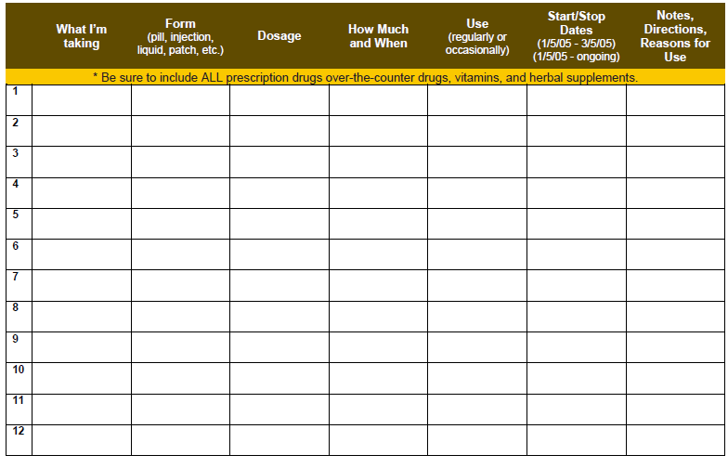
Patient-Centered Medication Lists
45

Slide 46
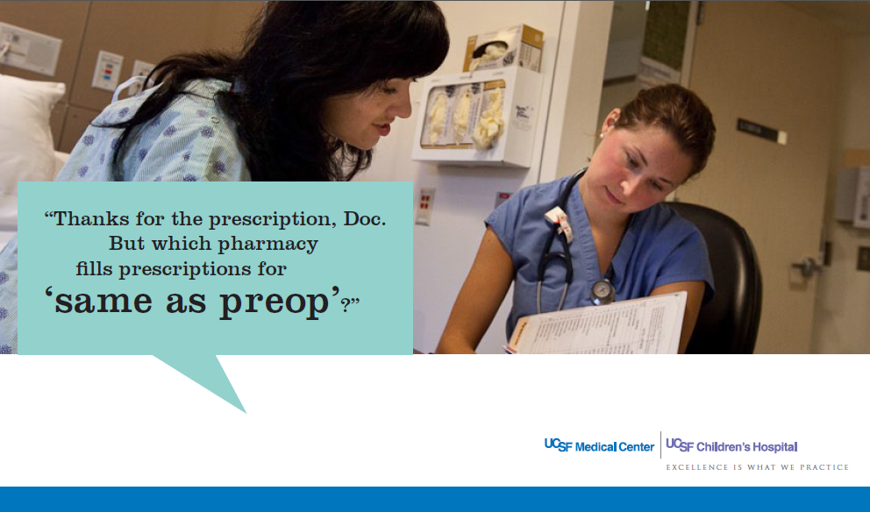
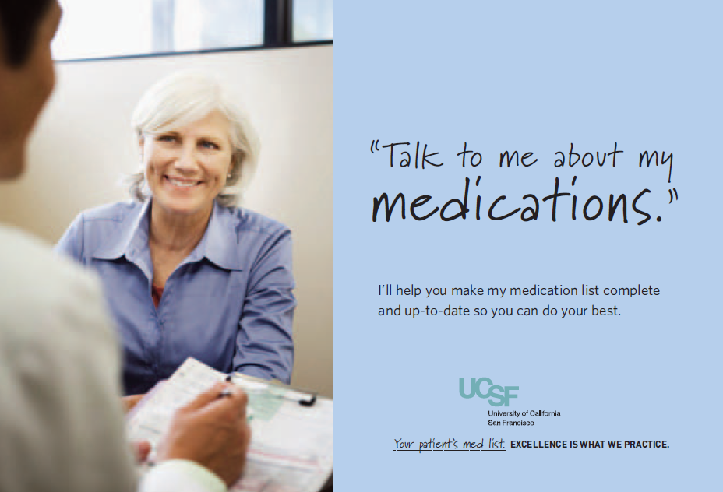
Sample Social Marketing Tools
46

Slide 47
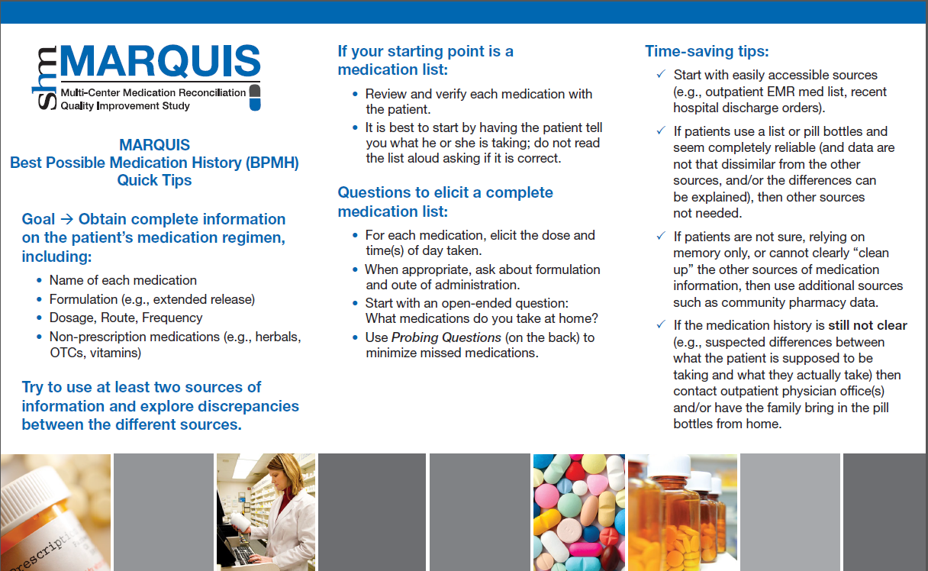
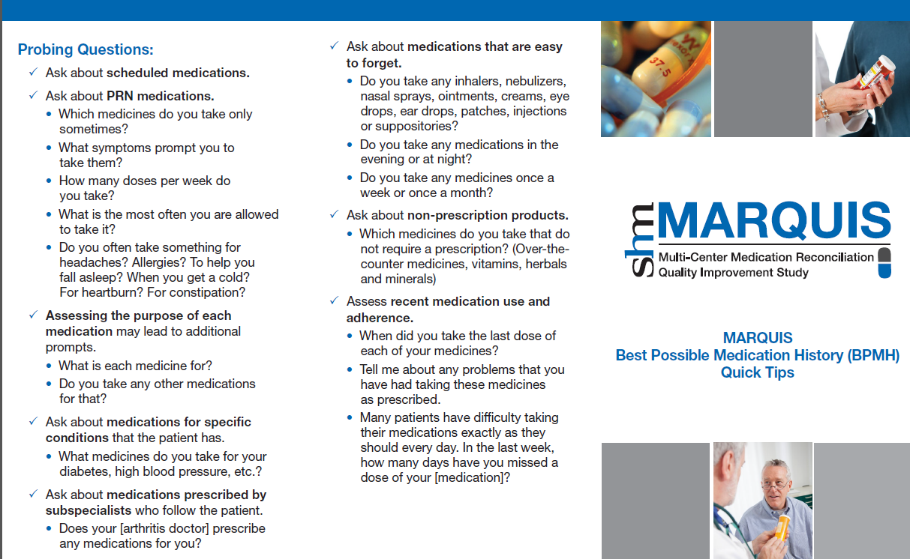
BPMH Tri-Fold Pocket Cards
  Provides a step by step guide for eliciting the best possible medication history from your patient
  Provides prompts for clinicians to use while efficiently conducting patient interviews
47

Slide 48
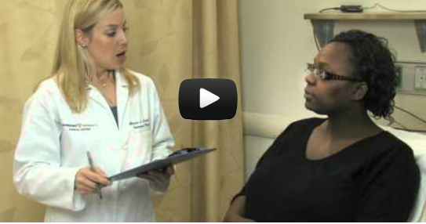
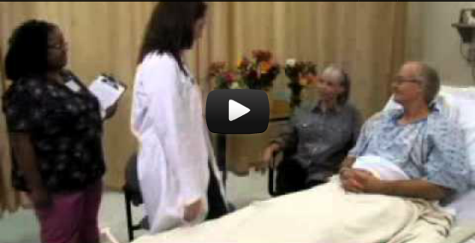
Health Communication Videos
  Produced at Vanderbilt. Content developed by MARQUIS team.
  Taking a good med history:
  Reviews the fundamentals of taking a BPMH while modeling correct interviewing technique
      Discharge counseling:
      Shows ‘typical’ discharge
      with contrasting optimal
      counseling techniques
48

Slide 49
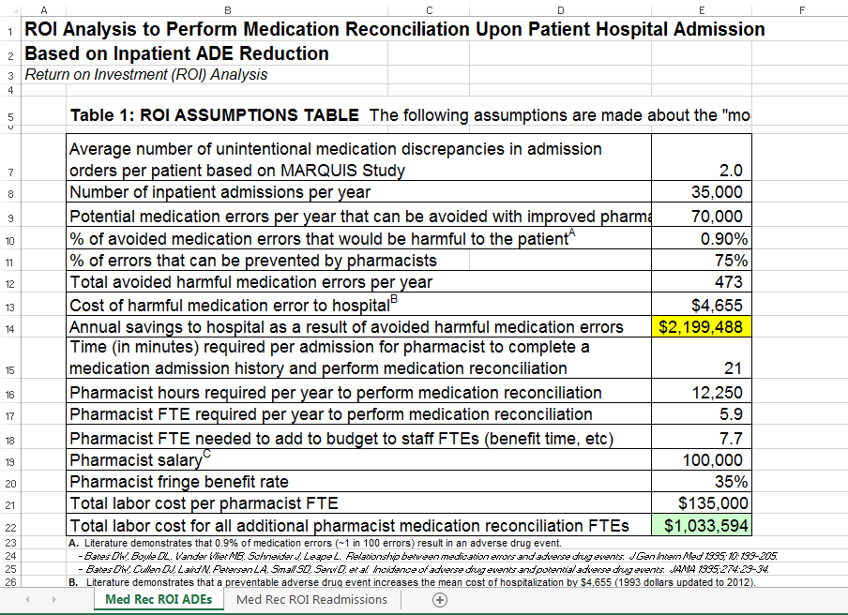
ROI Calculator
49

Slide 50
Mentored Implementation
Based on other multi-centered mentored implementation QI projects run by SHM
  Transitions in Care: Project BOOST
  VTE Prophylaxis
  Inpatient Diabetes
Training guide, website for mentors, additional teaching materials
Research database, data collection tools
50

Slide 51
Mentored Implementation
Implementation over 18 months
  Monthly phone calls with clearly defined agenda
  Central website
  Feedback on progress: processes and outcomes
  One site visit
Advantages of mentored implementation: provides
  Accountability
  Outside “voice of reason,” sounding board
  Content expertise in medication reconciliation
  QI expertise
51

Slide 52
MARQUIS Primary Study Outcome
Unintentional medication discrepancies
Study Pharmacist takes “Gold Standard” medication history using all available sources
Pharmacist compares it to team’s documented preadmission medication list (“PAML”), admission orders, and discharge orders
If discrepancy with admission or discharge orders:
  Determines if intentional or not based on medical record +/- clinician interview
Categorized by timing, type, and reason
Identical to new National Quality Forum measure
Data will be collected using RedCap to ensure confidentiality and security
Similar analysis plan to MARQUIS 1: measure improvement over time compared with baseline trends
52

Slide 53
Program Evaluation
RE-AIM Framework: informs future spread
  Reach: number and representativeness of sites that apply
  Effectiveness: number of unintentional medication discrepancies in admission and discharge orders
  Adoption: number and characteristics of units and services that adopt and don’t adopt the intervention
  Implementation: number and type(s) of intervention components adopted
  Maintenance: primary and secondary outcomes over time
Patient-Family Advisory Council
  Provides patient perspective throughout the study, especially patient-facing intervention components, public health messages, community engagement
Stakeholder Steering Committee
  NPSF, ASHP, The Joint Commission
  Provide ongoing advice and help with dissemination
53

Slide 54
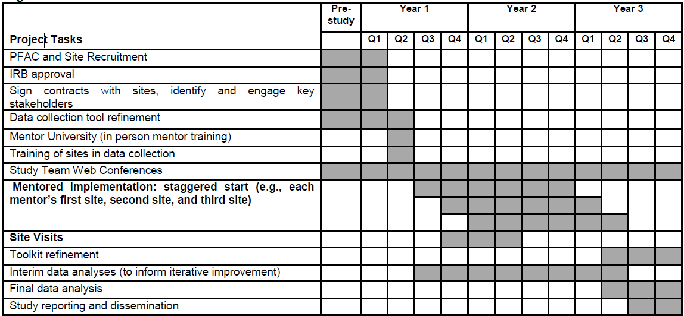
Timeline
October 1, 2015
WE ARE HERE
54

Slide 55
We are looking forward to talking with you during our first webinar!
Thanks!
55

Slide 56
Acknowledgments
Jason Stein, MD
Tosha Wetterneck, MD
Peter Kaboli, MD
Sunil Kripalani, MD, MSc
Stephanie Mueller, MD, MPH
Amanda Mixon, MD, MSPH
Stephanie Labonville, PharmD
Elisabeth Burdick, MD
E. John Orav, PhD
Jenna Goldstein
Nyryan Nolido
Jackie Minahan
56

Slide 57
Acknowledgments
John Gardella, MD
Becky Largen, PharmD
Hasan Shabbir, MD
Kathleen Herman, PharmD
Justin Metzger, PharmD
Amy Aylor, PharmD
Aaron Michelucci, PharmD
Pat Brown, MD
Randall Peto, MD
Andrew Auerbach, MD
Kirby Lee, PharmD
Mohammed Mousa, MD
Chaitanya Are, MD
Addie Seiler, MD
Stephanie Rennke, MD
Michael Hwa, MD
57

